Slide 1
COMP 3100
Week 15 - Monday

Slide 2
Last time
What did we talk about last time?
Mostly work days
Before that:
Execution and control
  Earned value management
  Planned Value, Earned Value, Actual Cost
  Burn charts

Slide 3
Questions?

Slide 4
Final exam format
Time: Friday, 12/13/2024 2:45 - 4:45 p.m.
The exam will have:
  Short answer questions
  At least one matching question
  One or two diagrams or figures you must create
  Two to three essay questions

Slide 5
Review

Slide 6
Managerial software engineering concerns
Managerial concerns are about organization and control
  Project cost
  Time estimation
  Scheduling and tracking
  Team management
  Risk management
  Quality

Slide 7
Technical software engineering concerns
Technical concerns are about what product, how to build it, and building it
  Software requirements
  Design
  Programming languages and environments
  Coding standards
  Defect prevention, detection, and removal
  Version control
  Documentation
  Maintenance

Slide 8
Management

Slide 9
Aspects of a project that must be managed
Scope
  How much the project is trying to accomplish
  Creep is the tendency for the work to increase
Time
  Must be reasonable for the project size
  Must be monitored
Cost
  Similar issues as with time
Quality
  How good is acceptable?
  Quality assurance must be done through the project, not just at the end
Resources
  Do you have the people (and tools) to get the job done?
Risks
  Have you planned for things going wrong?

Slide 10
Software development methods
Traditional methods
  Careful planning and hierarchical leadership
  Steps like requirement specification, design, implementation, testing, and maintenance
  Example: Waterfall model
Agile methods
  Constant iteration
  Self-directed teams
  Minimal documentation
  Example: Scrum
Both methods are widely used and many successful teams use aspects of both
The project for this class will mostly employ traditional methods because agile works best with experienced developers

Slide 11
Requirements and design
Requirements are functions or characteristics that software has
Customers or users determine the requirements
Stakeholder is a broad term that includes customers, users, developer, managers, and maybe the public
Designs specify how the software system will meet the requirements
Designs can look at a system from different aspects
Design patterns are standard solutions to problems that have been useful in the past and can help structure designs

Slide 12
Implementation
After the design is made, the software must be implemented in one or more programming languages
Compilers and interpreters are used to run the programs
Editors allow people to write code
Version control tools let people track the evolution of the code
Code checkers see if the code is meeting certain standards
Debuggers help programmers find mistakes

Slide 13
Version Control

Slide 14
Version control
For any large software project (and even small ones), it's valuable to have a way to track changes over time
Such tools are called version control systems
They allow:
  Changes to be tracked over time
  Developers to check code into repositories
  Comparison of files over time
  Documentation of changes made
It's more than just a glorified backup system

Slide 15
Repository
A repository is where all the development data is stored
  Usually called repos by professionals
Repositories include the current source code as well as a history of all the changes ever made
For source code, most version control systems use delta compression, meaning that only the differences between files are stored
Thus, hundreds of versions of your code can be stored without taking up hundreds of times the space

Slide 16
Actions
Committing a file is adding its changes to a repository
Cloning means creating a copy of another repository, including history
Merging is combining two sets of files with independent changes into one set with changes from both
Pulling (or fetching) copies the changes from an outside repository and adds them to the current repository
Pushing copies the changes from the current repository to an outside repository

Slide 17
Philosophy of Git
Git is a distributed VCS
Every computer has a complete history of all the changes, ever
There's no central server
Programmers make changes and push them to or pull them from other repositories
All operations are designed to be fast
Torvalds did a pretty good job, but some common tasks are confusing

Slide 18
Git process
Add
Commit
Push
Working Directory
Staging (Index)
Local Repository
Remote Repository
Reset
Fetch
Pull
It's all possible to reset to an earlier commit, overwriting the working directory, but it's confusing to put that arrow in.

Slide 19
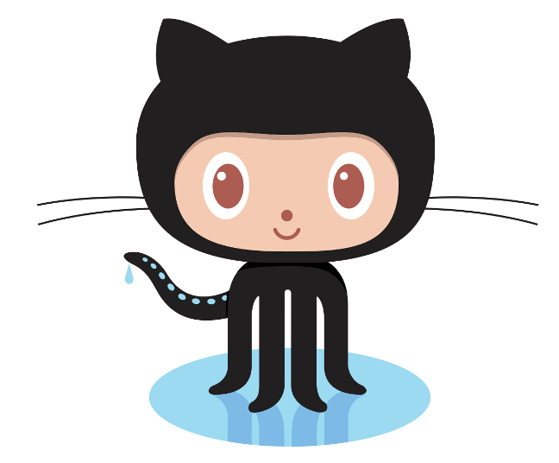
GitHub
GitHub.com provides online repositories for code
  Private repositories (except for education) are not free
  Public repositories are free
Git can be used without GitHub
GitHub can even be used without Git (since it has support for SVN)
Git has nice tools for:
  Visualizing who's committing and how much they have changed
  Issue tracking
  Writing commit information and Read Me files
  Pushing and pulling repos stored on GitHub
  Creating webpages related to releasing software
Ironically, Linus Torvalds hates GitHub

Slide 20
Requirements

Slide 21
Stakeholders
Stakeholders are anyone affected by a product or its development
  Customers are the people that pay for a product
  Users are people who interact with the product
  Clients are people for whom software was created (includes both customers and users)
  Developers are all the people who work on the project
  Regulators are responsible for ensuring that software meets standards
  Marketers stand in for clients when making mass-market products

Slide 22
Stakeholder needs
A stakeholder need is a feature that one or more stakeholders want
Sometimes, these needs are written in descriptions called needs specifications
Then, developers have to wrangle all of these conflicting, incomplete, and vague needs into a requirements specification
Traditional methods may have a specific person who does this
  Titles like requirements analyst, requirements specialist, user interaction designer

Slide 23
Functional requirements
It's common to divide requirements into functional and non-functional categories
Functional requirements are about how software takes input and turns it into output, its behavior
  Appearance
  User interface actions
  Input and output processes
Most requirements are functional requirements, and they take the most time and effort to specify

Slide 24
Non-functional requirements
Non-functional requirements describe the properties software must have
  Speed of processing
  Amount of memory used
  How often failures can be permitted
  Level of security
  Ease of modification
  Cost of development
  Platforms the product must run on
Non-functional requirements are more abstract than functional requirements
Functional requirements are tied to specific pieces of code, but non-functional requirements are properties of the whole system

Slide 25
Problems with requirements in traditional processes
It's really hard to figure out all the requirements before doing any coding and looking at prototypes
The world changes quickly, especially in technology, and people's desires change
Writing all the requirements takes a lot of work, creates large documents, and costs a lot of money
The waterfall process means that nothing is ready for a long time (often years) after the project starts, and some projects get canceled

Slide 26
Requirements in agile processes
Agile developers try not to write requirements at all
  But you have to start with something...
Stakeholder needs are turned into lists called product backlogs
A product owner adds to the product backlogs and prioritizes them
High priority items are chosen for each sprint, the agile term for a development iteration

Slide 27
How Scrum tries to make changing requirements cheap and easy
Delay choosing requirements as long as possible
  Stakeholder needs can be easily added or removed from the product backlog
  Requirements are set only for the product backlog items (PBIs) when they're implemented on a sprint
Delay refinement as long as possible
  PBIs are broken down until they're small enough and detailed enough for a single sprint
  User-level requirements are refined into operational- and physical-level requirements for the sprint where they're implemented
Avoid writing requirements altogether
  Instead of writing down physical-level requirements, talk to the stakeholders and implement what they say in the sprint
Determine requirements in light of current product features
  Because agile methods iterate on an existing product, everyone can see which features would be most useful next

Slide 28
Stating specifications in traditional processes
Specifications are usually made in declarative English (or appropriate natural language) sentences
Problem: English is vague and confusing
Rules for good technical writing:
  Write complete, simple sentences in the active voice
  Define terms clearly and use them consistently
  Avoid synonyms
  Group related material into sections
  Use tables, lists, indentation, white space, and other formatting aids
Use "must" or "shall" to describe behaviors the product must do

Slide 29
Testable requirements
Requirements should be testable or verifiable
This means that there can be a process for testing whether the product meets the requirement
Bad requirement:
  The product must display query results quickly.
Good requirement:
  The product must display query results in less than one second.
The bad requirement isn't testable because "quickly" is subjective
The good requirement is testable because we can time the finished system

Slide 30
Requirements traceability
We want a clear relationship between a requirement, a part of the design, the code that implements this design, and the tests that verify it
Being able to connect the requirements to later stages of development is called requirements traceability
To make requirements more traceable, each specification should state only a single requirement
  This kind of specification is called atomic
Non-atomic specification:
  The product must display a list of previous commands and the results of commands, each in its own window.
The goal is simplicity and clarity
A long list of simple requirements is better than a short list of confusing, complex requirements

Slide 31
Stating specifications in agile processes
Agile developers have some documents like product vision statements and product backlog items
A very common way to describe requirements is through user stories
A user story describes a function that the product provides to users
Sometimes a big story that is a huge chunk of the application is called an epic
Sometimes a story that would take several sprints to implement is called a feature
A story that can be implemented in a single sprint is a sprintable story or an implementable story
Note: Some agile people only use the term user story for sprintable stories

Slide 32
User voice form
A common way of expressing user stories is user voice form:
  As a <role>, I want to <activity> so that <benefit>.
  <role> is replaced by a user role, which is some category of user
  <activity> is a function that the system does
  <benefit> shows the value of the activity but is an optional part of user voice form
Example:
  As a payroll clerk, I want to enter salary data so that payrolls will use adjusted salaries.

Slide 33
Eliciting stakeholder needs in traditional processes
It can be difficult to discover what stakeholders actually want from a product
Some approaches:
  Interviews: Ask individual stakeholders what they want and record the answers
  Observation: Watch the users doing tasks, asking them to describe the actions they're taking
  Focus groups: Informal discussion with six to nine people and a facilitator
  Workshops: A meeting focused on documenting the desires of many stakeholders
  Prototypes: Let stakeholders respond to different version of a product
  Document studies: Read documents associated with the business that needs the product
  Competitive product studies: Analyze similar existing products for strengths and weaknesses

Slide 34
Eliciting stakeholder needs in agile processes
Agile processes don't focus on getting all the requirements up front
Instead, a cornerstone of the agile approach is constantly getting feedback, allowing for quick responses
The product itself becomes an evolving prototype that it easy to understand and unlikely to become obsolete
Potential problems:
  Stakeholders can overreact to current problems and lose sight of the big picture
  Agile methods give a lot of power to the few stakeholders who give feedback, and others might be ignored

Slide 35
Requirements management in traditional processes
Projects start with a product mission statement giving business requirements
Requirements analysis is the process of gathering stakeholder needs and using them to turn the mission statement into a list of requirements specifications
The result is a document called a software requirements specification (SRS)

Slide 36
Requirements management in agile processes
The mission statement or other high-level needs are used to write big user stories
Working with stakeholders, the team refines sprintable stories into operational-level and physical-level requirements
The product owner has the responsibility to update the product backlog as the product evolves

Slide 37
Kinds of requirements modeling
Model | Show | Typical UML Diagram
Use Case Models | A product interacting with its environment, often actors who take on roles | Use Case Diagram
Conceptual Models | Relationships between entities | Class Diagram
State Diagrams | The states a product can be in and the transitions between those states | State Diagram
Decision Trees and Tables | What a product should do under various conditions | Activity Diagram
Data Flow Diagrams | How data enters, is processed, and leaves the product | Activity Diagram or Sequence Diagram

Slide 38
UML

Slide 39
Modeling
At both the requirements stage and the design stage, modeling can be useful
Modeling mostly means drawing boxes and arrows
We want high-level descriptions of:
  What the thing is supposed to do
  What parts it's composed of
  How it does what it does

Slide 40
System modeling
Models leave out details
Models are useful to help understand a complex system
  During requirements engineering, models clarify what an existing system does
  Or models could be used to plan out a new system
Models can represent different perspectives of a system:
  External: the context of a system
  Interaction: the interactions within the system or between it and the outside
  Structural: organization of a system
  Behavior: how the system responds to events

Slide 41
UML
The Unified Modeling Language (UML) is an international standard for graphical models of software systems
A few useful kinds of diagrams:
  Activity diagrams
  Use case diagrams
  Sequence diagrams
  State diagrams
Class diagrams are important enough that we'll talk about them in greater detail

Slide 42
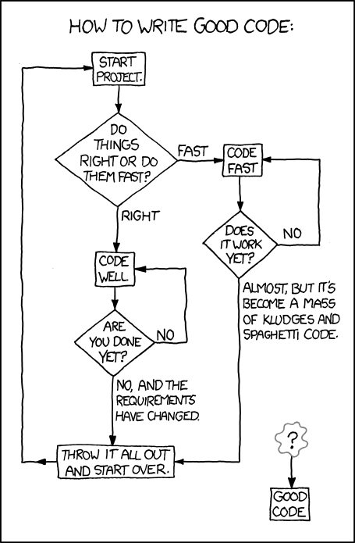
Activity diagrams
Activity diagrams show the workflow of actions that a system takes
XKCD of an activity diagram for writing good code
  From: https://xkcd.com/844/
Formally:
  Rounded rectangles represent actions
  Diamonds represent decisions
  Bars represent starting or ending concurrent activities
  A black circle represents the start
  An encircled black circle represents the end

Slide 43
More detailed activity model

Slide 44
Data-driven modeling
Data-driven models show how input data is processed to generate output data
The following is an activity diagram that shows how blood sugar data is processed by a system to deliver the right amount of insulin

Slide 45
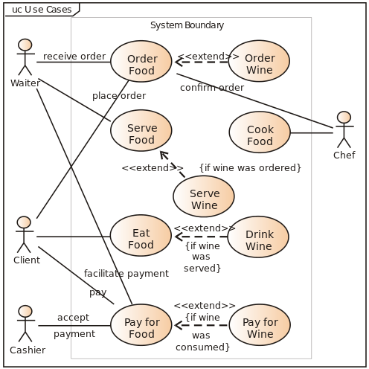
Use case diagrams
Use case diagrams show relationships between users of a system and different use cases where the user is involved
Example from Wikipedia:

Slide 46
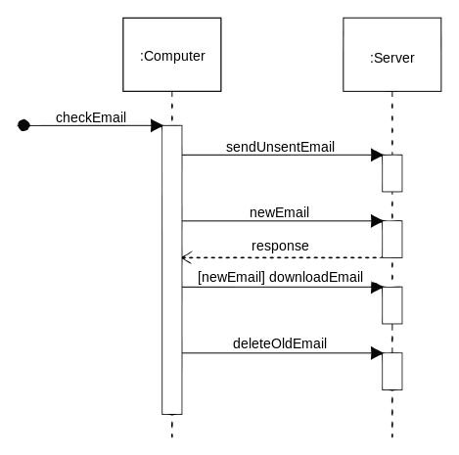
Sequence diagrams
Sequence diagrams show system object interactions over time
These messages are visualized as arrows
  Solid arrow heads are synchronous messages
  Open arrow heads are asynchronous messages
  Dashed lines represent replies
Example from Wikipedia:

Slide 47
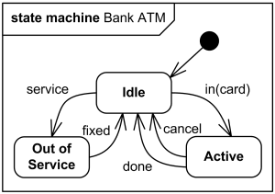
State diagrams
State diagrams are the UML generalization of finite state automata from discrete math
They describe a series of states that a system can be in and how transitions between those states happen
Example from uml-diagrams.org:

Slide 48
Event-driven modeling
Event-driven modeling is another kind of behavioral modeling that focuses on how a system responds to events rather than on processing a stream of data
Here's a state diagram for a microwave oven based on various outside events

Slide 49
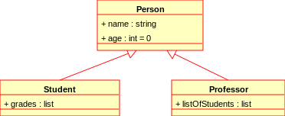
Class diagrams
Class diagrams show many kinds of relationships
The classes being described often (but not always) map to classes in object-oriented languages
The following symbols are used to mark class members:
  + Public
  - Private
  # Protected
  / Derived
  ~ Package
  * Random
Example from Wikipedia:

Slide 50
Relationships
Associations between classes can be drawn with a line in a class diagram
Notations can be used to mark relationships as one to one, many to one, many to many, etc.
These kinds of relationships are particularly important when designing a database

Slide 51
Generalization
Classes can be listed with their attributes
However, there are often classes that share attributes with each other
Some classes are specialized versions of other classes, with more attributes and abilities
This relationship between general classes and more specialized classes is handled in Java by the mechanic of inheritance

Slide 52
Aggregation
Another way of using class diagrams is to show that some objects or classes are made up of smaller parts represented by other classes
A diamond shape is used to mark a class that is the whole, and its parts are connected to the diamond

Slide 53
Software Processes

Slide 54
Waterfall lifecycle model
Product
Vision
Requirements
SRS
Design
SDD
Implementation
Code
Testing
Software Product
Rounded rectangles are actions (tasks)
Squared rectangles are documents (data)
Maintenance

Slide 55
Advantages of waterfall
The whole product is specified
The project to create it is planned early
This approach is important for large and complicated products from a management perspective
  Size, cost, delivery dates, etc.
By comparing to the plan, it's easy to tell if a product is on-time and on-budget
If it isn't, managers can take actions
  Increase time, increase budget, reduce scope, etc.

Slide 56
More advantages of waterfall
If each step is done completely and correctly, all mistakes are found before moving on to the next step
  This ends up being the major disadvantage of waterfall, too, since mistakes usually propagate to future steps
Good documentation is created for each step
  This is really important when new people are added to the project
Each phase is distinct, allowing it to be carried out by teams that specialize in that phase
  For multiple projects, appropriate teams can be scheduled for maximum efficiency

Slide 57
Disadvantages of waterfall
Requirements can't change
  But they usually do
  If requirements change, all the advantages of waterfall's predictability disappear too
Even when requirements stay the same, it's hard to be complete and consistent in documenting them
Creating all the documentation for waterfall is expensive
If you have separate teams for each phase, each team has to learn what has already been done

Slide 58
More disadvantages of waterfall
Because there are so many teams, a lot of management is needed
  Drives up the cost
  Heavyweight processes are ones with a lot of documentation and management
There's no product until completion of the entire project
  Could take years
  We don't realize the problems until the product is available
  Clients might not want the product anymore

Slide 59
To waterfall or not to waterfall?
Waterfall was the only process for a long time
Its track record isn't great
  Success only about 25% of the time historically, but the rate is improving
Waterfall only works when the requirements are stable
Waterfall has a lot of overhead
  Might be justified for large projects
  Isn't justified for small projects
Use waterfall only for large projects with stable requirements or when there are very high safety, security, or reliability requirements

Slide 60
Prototyping
A prototype is a working model of a finished product
  It can model a part or the whole
Prototypes can help offset problems with the waterfall model
Prototypes are particularly helpful with testing out UI decisions
Prototypes are easy(ish) to make and change
  Try out several!
  See which one is the better design
Throwaway prototypes are just used for making specifications and then thrown out
Evolutionary prototypes are modified into the final product

Slide 61
Prototyping process
Product
Vision
Prototypes can be used within the waterfall model
Or they can be used for an entirely prototype-based lifecycle model:
This idea is what incremental and agile processes are built around
Design
Implementation
Prototype
Demo and Evaluation
Software Product
Complete
Incomplete

Slide 62
Advantages of prototyping
Changes to specifications are easy to handle
Customers are more likely to get what they want (since they get regular opportunities for feedback)
Customers can get (potentially) useful software quickly
Not much documentation or management is needed
  Lightweight development process

Slide 63
Disadvantages of prototyping
Without the planning of a process like waterfall
  It's hard to predict a reasonable deadline for the final product
  It's hard to predict the budget
Product design might be bad since the product evolved without following a plan
  The biggest problem here is maintainability: How can new features be added?
An undisciplined process can have poor quality control
  The product might be unreliable or buggy

Slide 64
Risk management
A risk is an event with negative consequences
  Losing source code
  Losing a team member
  Finding an unexpected design flaw
  Underestimating the time needed to write a piece of code
Business people think about risk a lot
Risk management is identifying, analyzing, controlling, or mitigating risks
Risk management should be incorporated into all software lifecycle processes

Slide 65
Iterative and Incremental Processes

Slide 66
Iterative and Incremental Processes
An iterative process contains repeated tasks
  Example: While debugging code, you might run tests, do fixes, run tests, do fixes, and so on
An incremental process produces output in parts
Processes can be either iterative or incremental, both iterative and incremental, or neither
The purest version of waterfall is neither
  It's not iterative because each phase is separate and not repeated
  It's not incremental because a working product is only available at the end

Slide 67
Iterative processes
Iteration is the main way you get quality
  It's just so hard to get it right the first time!
  Software development still involves significant trial and error
Even the waterfall model usually has iterative steps in practice
Prototype evolution is iterative
The problem with iteration is rework
  Redoing or throwing out previous work

Slide 68
Incremental processes
Iteration is found lurking everywhere to greater or lesser degrees, but being incremental is more binary
To be incremental, final products must be produced along the way
Waterfall is not incremental because the products produced along the way are just used for the next step

Slide 69
Agile
Versions of waterfall were the only commonly used software development model until the 1990s
A lot of people were unhappy with it
In response, some developers created the Agile Manifesto, a statement about developing software that was diametrically opposed to waterfall
The ideas caught on, and many developers embraced the idea, creating a series of different methods
Sometimes businesses claimed to be changing over to agile methods but really just renamed parts of their waterfall approach

Slide 70
Agile manifesto
We are uncovering better ways of developing software by doing it and helping others do it. Through this work we have come to value:
Individuals and interactions over processes and tools
Working software over comprehensive documentation
Customer collaboration over contract negotiation
Responding to change over following a plan
That is, while there is value in the items on the right, we value the items on the left more.

Slide 71
Agile characteristics
The ideas caught on, spawning specific methods such as Extreme Programming, the Crystal Method, Dynamic System Development Method, and Scrum
These methods all have the following characteristics:
  Incremental process with increments ranging from a week to a few months
  Customers are closely and continuously involved in the product
  Lightweight process minimizing documentation and management tasks
  Test driven, using automated test suites to avoid the problems of frequent code change

Slide 72
Agile lifecycle
Product
Vision
Refine Specifications
Agile processes are similar, following a lifecycle much like the one on the right
Create Increment
Deliverable Product
Evaluate Increment
Improve Process
Realization
Released
Not Released

Slide 73
Agile advantages
Product specifications can change without destroying all the work that's been done
Customers get a software product quickly
  With new versions coming frequently
Bad projects can be canceled early
Time is saved because of lightweight requirements for documentation and management
Duplication of effort is usually reduced

Slide 74
Agile disadvantages
Customers have to be involved constantly, but most customers don't want to spend their time giving feedback
Continuous refinement of a product can lead to a bad design through an evolution of ideas that seemed like a good idea at the time
For large projects, it's hard to coordinate many teams on a product that is evolving unpredictably without documentation
It's hard to predict the outcomes of agile methods

Slide 75
Scrum

Slide 76
Scrum process
Create Product Backlog
Product
Vision
Product Backlog
Like other workflows, Scrum can be modeled with an activity diagram showing familiar steps
Everything is built around a cycle called a sprint
Because sprints repeat, the process is iterative
Because each sprint produces a shippable product, the process is incremental
Sprint Planning
Sprint Backlog
Sprint Execution
Sprint Backlog
Product Backlog
Shippable Product
Sprint Review
Product Backlog
Sprint Retrospective
Project Not Done
Project Done

Slide 77
Sprints
Recall that agile methods are built around a product backlog, containing high-level descriptions of the desired features of the product
  Items can be added to or removed from the product backlog at any time
Some of the product backlog is chosen for a sprint
  Making the sprint backlog
The sprint backlog is implemented, making a new shippable product
A sprint review allows customers to give feedback on the product
The sprint retrospective is used to figure out how to do the next sprint better

Slide 78
Scrum roles
Product owner (PO)
  Responsible for what's in the product
  Customer representative to the other developers
  Updates the product backlog
Scrum master (SM)
  Guides the team through the Scrum process
  Facilitator and coach
  Protects the team from outside interference
Team members
  People who decide how to build the project and build it
  Typically, everyone works on everything

Slide 79
Scrum artifacts
Product backlog
  A prioritized list of product features that haven't been implemented yet
  Product backlog items (PBIs) are the elements of this list
  Priorities are based on business value
Sprint backlog
  Subset of PBIs
  Tasks needed to complete them
  Estimates of effort needed for each one
Potentially shippable increment (PSI)
  Product that could be shipped to the customer (though maybe without all the desired features)
  A PBI on the sprint backlog that wasn't finished goes back into the product backlog

Slide 80
Scrum activities
Product backlog creation
  The PO creates the product backlog for the first time, using customer input
Product backlog refinement
  The PO constantly adds and deletes PBIs from the product backlog based on feedback from stakeholders
Sprint planning
  The PO, SM, and other team members select PBIs, maybe with a particular sprint goal
  PBIs are chosen by priority, taking into account how much can be done by estimating the work for the tasks for a PBI
Sprint execution
  Everyone performs the tasks to implement the sprint backlog PBIs
Sprint review
  A product demo where stakeholders discuss what was added and how they feel about it
  Goal: improving the product
Sprint retrospective
  The team discusses what went well, what didn't, and how the next sprint can be better
  Goal: improving the process

Slide 81
Managing the product backlog
The product backlog is a prioritized list of PBIs
Each PBI consists of
  Specification
  Priority
  Estimate of effort
  Acceptance criteria

Slide 82
PBI priorities
In addition to the specification of functionality, every PBI should have a priority
Priorities express how important the PBI is and can be expressed as a number or a rubric (low, medium, high, critical)
The PO sets the priorities based on stakeholder feedback
Dependencies also determine priorities: If X is needed for Y, then the priority of X must be at least as high as Y
High-priority PBIs should be small enough to do in a single sprint

Slide 83
PBI effort estimates
Each PBI must have an effort estimate
High-priority, sprintable PBIs need precise estimates (such as person-days), to aid in sprint planning
Low-priority, abstract PBIs are further from sprintable status and only need rough estimates (small, medium, large, gigantic)
As PBIs are refined, their effort estimates need to become more precise

Slide 84
PBI acceptance criteria
How do we know when a PBI is done?
Acceptance criteria are checks a user can do to see if a PBI is finished and correct
Often, these form a test suite used by developers
Following the same pattern of steady refinement, high-priority PBIs should have detailed acceptance criteria
  These acceptance criteria might be further refined during the sprint

Slide 85
Product backlog refinement
Refining or grooming the product backlog means:
  Adding, removing, or modifying PBIs
  Making PBIs nearing the top of the product backlog more detailed
  Re-estimating and re-prioritizing PBIs
  Adding acceptance criteria to PBIs
Refinement happens during sprint review
It should happen at least once during a sprint to make sure there are enough sprintable stories for the next sprint
A PO can use a spreadsheet to manage the product backlog, but there are also specialized tools

Slide 86
Estimating work and timeline
Two pieces of information are needed: The size of the job and the speed of the team
PBIs are estimated by story points or ideal hours
One or two story points is supposed to be how much effort the smallest stories take
  Bigger stories are estimated relative to that size
An ideal hour or a person hour is the amount an average developer can accomplish in one uninterrupted hour of work
Story points are more commonly used, since they're easier to estimate

Slide 87
Velocity
Velocity is the amount of work done per sprint
After a sprint, story points or ideal hours can be added up to see how much got done
Past velocities can be used as a guide for how many story points can get done when planning the next sprint
Ideally, tracking this information will help get better estimates of story points and ideal hours for other stories and also a better estimate of team velocity

Slide 88
Sprinting
Sprinting is actually doing the implementation
Sprinting is considered a time-boxing technique, where the amount of work done is based on the time available
  Rather than letting time expand as needed to finish a task
For a given project (and at a given company) sprints are usually the same length, somewhere between a week and a month
Short, consistent sprints are easier to plan and track and give rapid feedback
If PBIs can't be finished during a sprint, they go back on the product backlog
If a team finishes all PBIs before the sprint is over, they can get another one from the PO

Slide 89
Sprint review
At the end of a sprint, there is a sprint review to reflect on how the product is changing
All stakeholders are invited
Sprint review outline:
  Starts with the overall sprint goal and the PBIs in the sprint backlog
  Team lists the PBIs completed and explains why some didn't get done
  New aspects of the product are demonstrated
  Everyone discusses how to make the product better
Results of the review are used for planning the next sprint

Slide 90
Sprint retrospective
At the end of a sprint, there's also a sprint retrospective
Only the development team, including the PO and the SM, are invited
The retrospective is for analyzing how the team is working and how to improve
Improvements tend to be clear when a new team is working on a new product
  It may still take several sprints for an improvement to get fully integrated into the process
Over time, the team can become comfortable with the process, but finding improvement opportunities is still important

Slide 91
Software Quality Assurance

Slide 92
Quality assurance
Quality assurance (QA) is a system for making sure the product satisfies stakeholder needs
QA focuses on two distinct goals:
Validation
  Testing if the product satisfies stakeholder needs
  "Are we building the right product?"
  Example: Does the customer want steak and fries?
Verification
  Testing if the product satisfies needs properly
  "Are we building the product right?"
  Example: Are the steak and fries cooked well?

Slide 93
Defect prevention
There is no one way to prevent defects
Instead, preventing defects must be built into the software development processes that the entire organization uses
  Process improvement is making a process better
  Training and education are necessary
Process guides such as documentation standards and style guides help
Using well-studied design methodologies (such as OOP) can help

Slide 94
Reusing ideas
Reusing design architectures that have been successful in the past can prevent defects
  Examples: MVC and pipe-and-filter
Design patterns are standard patterns for OOP classes
  Examples: decorator and factory
Using well-studied algorithms and data structures helps a great deal
Reusing code (often from libraries) is smart, especially since those libraries have been tested thoroughly

Slide 95
Formal methods and prototypes
Formal methods include systems for mathematically checking that code does what it's supposed to
  Not all code can be modeled mathematically
  Yet some of these systems have found bugs in real software, such as TimSort, the most commonly used sort in Python and Java
Prototypes let us explore what defects might happen before putting them in the final product
  The opposite end of the spectrum from formal methods, since prototypes are practical rather than theoretical

Slide 96
Tools
Many tools help reduce defects
Version control tools help track code over time
Configuration management tools allow changes in one tool to automatically update other tools
  Examples: Puppet and Ansible
Integrated development environments (IDEs), once called computer aided software engineering (CASE) tools, can integrate many useful tools for defect prevention
  Syntax highlighting
  Two-way translation between code and UML models
  Style checking

Slide 97
Defect detection and removal
A good process can't keep out all defects
Some defects will show up and must be found and removed
Defect detection and removal techniques fall into two categories:
  Review and correct
  Test and debug
Review and correct methods look at the code while test and debug methods look at the product in operation

Slide 98
Review and correct methods
There's a formal name for just looking at your code for errors: a desk check
A walkthrough is when you explain your code to someone else
An inspection is a more formal process with trained inspectors
Inspection roles:
  Moderator schedules and runs the meeting and distributes the code
  Author of the code
  Reader who guides the meeting
  Recorder who takes notes
  Inspectors who check code before and during the meeting

Slide 99
Test and debug
Testing software helps find cases that are not obvious from looking at the code
Software testing has some jargon:
  A failure is a deviation between actual behavior and intended behavior
  A fault is a defect that can give rise to a failure
  A trigger is a condition that causes a fault to result in a failure
  A test case is a set of inputs and program states
  A collection of test cases is a test suite
Debugging is using trigger conditions to find and fix faults

Slide 100
Overview of testing
Unit Testing
Integration Testing
Alpha Testing
Beta Testing
Unit tests test a small piece of code (method or class) in isolation from other code
  Often done by the author
Integration tests test several small pieces of code together
  By the author, a testing team, or both
Alpha and beta tests test the whole product
  Alpha tests usually have a testing team
  Beta tests include users
System Testing

Slide 101
Breaking it all down
Defect Elimination
Defect Prevention
Process Guides
Analysis and Design Methods
Reference Architectures
Design Patterns
Data Structures and Algorithms
Software Reuse
Prototyping
Version Control
Configuration Management
IDE Tools
Training and Education
Defect Detection and Removal
Review and Correct
Style and Standards Checkers
Spelling and Grammar Checkers
Reviews
Desk Checks
Walkthroughs
Inspections
Test and Debug
Regression Testing
Unit Testing
Integration Testing
System Testing
Alpha Testing
Beta Testing

Slide 102
User Interaction Design

Slide 103
Interaction design
Interaction design is planning out the user experience (UX) for a software product
It cares about how the product looks and sounds (and, one day, smells?) and how the user gets output and puts input into it
This field used to get little attention from computer scientists, but it's really important
  Apple is a great posterchild for showing off the value of UX
  Even Microsoft, maligned for its user interfaces, has invested lots of money studying how to make windows and icons easier to use
UX is part of the field of human computer interaction (HCI), which combines ergonomics, physiology, psychology, and graphic design with computer science
The quality of a user interface is called its usability

Slide 104
User interaction design goals
Effectiveness: User can access all the features they need
Efficiency: Users can achieve their goals quickly
Safety: Users and computers aren't harmed
Learnability: Users become proficient quickly
Memorability: Users regain proficiency quickly after time away from the product
Enjoyability: Users experience positive emotions when using the product
Beauty: Users find the product aesthetically pleasing

Slide 105
Interaction design models
Before coding the UX, models are incredibly helpful to plan out how it looks and behaves
Static interaction design models show the audio and visual parts of the product that don't change during execution
Dynamic interaction design models show behavior during execution
Both are useful

Slide 106
Use case diagrams
A use case is an interaction between a product and its environment
An actor is an agent that interacts with a product
Use case diagrams (which we've seen before) are static interaction design models that represent the actors that interact with use cases

Slide 107
Layout diagrams
Screen layout diagrams and page layout diagrams are drawings of a product's visual display
A wireframe is a low-fidelity version that gives a rough layout without a lot of detail
It's good to start with a wireframe and refine it with more detail later

Slide 108
Use case descriptions
A use case diagram shows which actors interact with use cases
However, it doesn't explain what they do
A use case description is formatted text that explains the actions that an actor makes
The use case description is a dynamic interaction design model
Example template:
Use Case Name | To identify the use case
Actors | The agents participating in the use case
Stakeholders and Needs | What this use case does to meet stakeholder needs
Preconditions | What must be true before this use case begins
Post conditions | What will be true when this use case ends
Trigger | The event that causes this use case to begin
Basic Flow | The steps in a typical successful instance of this use case
Extensions | The steps in alternative instances of this use case due to variations in normal flow or errors

Slide 109
SAC principles
Design principles favor certain characteristics to make a design better
SAC principles are three general interaction design principles
Simplicity
  Simple designs are better
  Lots of options are confusing for the user
  It's better to make commonly used options easy and require a little more work for unusual options
Accessibility
  Designs that can be used be more people are better
  Considerations: color blindness, things too small to see or interact with
Consistency
  Designs that present data in similar ways are better
  Example: use consistent navigation controls

Slide 110
CAP principles
CAP principles are focused on appearance
Contrast
  Designs that make different things obviously different are better
  Example: italics and bold
  Example: font size to distinguish headings from text
Alignment
  Designs that line up on a grid are better
  Indentation is useful
Proximity
  Designs that group related things together are better

Slide 111
FeVER principles
FeVER principles are about behavior
Feedback
  Designs that acknowledge user actions are better
  Otherwise, how do you know if what you're doing has an effect?
Visibility
  Designs that display their state and available operations are better
  Are we in Arm Bomb or Disarm Bomb mode?
Error Prevention and Recovery
  Designs that prevent user errors and allow error recovery are better
  Prevention example: disable buttons that shouldn't be pressed
  Recovery example: allow undo or ask "Are you sure?" before doing something dangerous

Slide 112
Software Engineering Design

Slide 113
Simplicity
As with interface design, simpler designs are better
What is simplicity?
  Fewer lines of code
  Fewer control structures
  Fewer connections between different parts
  Fewer computations with different kinds of objects
A good rule of thumb is which design is easiest to understand
Simplicity is a good goal, but some important algorithms in computer science are necessarily complex
Everything should be made as simple as possible, but not simpler.
-Attributed to Albert Einstein, who probably did not say it quite like that

Slide 114
Small modules
Designs with small modules are better
Smaller modules are easier to read, to write, to understand, and to test
Miscellaneous guidelines:
  Classes should have no more than a dozen operations (methods)
  Classes should be no more than 500 lines long
  Operations should be no more than 50 lines long
  I have heard that you should be able to cover a method with your hand
Of course, it is often impossible to follow these guidelines

Slide 115
Information hiding
Each module should shield the internal details of its operation from other modules
Declare variables with the smallest scope possible
Use private (and protected) keywords in OOP languages to hide data (and even methods) from outside classes
Advantages of information hiding:
  Modules that hide their internals can change them without affecting other thins
  Modules that hide information are easier to understand, test, and reuse because they stand on their own
  Modules that hide information are more secure and less likely to be affected by outside errors
This is why we use mutators and accessors instead of making members public

Slide 116
Minimize module coupling
Module coupling is the amount of connectivity between two modules
Modules can be coupled in the following ways:
  One class is an ancestor of another class
  One class has a member whose type is another class
  One class has an operation (method) parameter whose type is another class
  One operation calls an operation on another class
If there two modules have many of these couplings, we say that they are strongly coupled or tightly coupled
When modules are strongly coupled, it's hard to use them independently and hard to change one without causing problems in the other
Try to write classes to be as general as possible instead of tied to a specific problem or set of classes
Using interfaces helps

Slide 117
Maximize module cohesion
Module cohesion is how much the stuff in the module is related to the other stuff in the module
We want everything in a class to be closely related
It's best if a class keeps the smallest amount of information possible about other classes
More module cohesion usually leads to looser module coupling
Sometimes a module being hard to name suggests that its data or operations are not cohesive

Slide 118
Design process
Design Problem
Analyze Design Problem
The design process is a microcosm of the larger software development process
The steps are analyzing the problem, proposing solutions (and looking up existing solutions to similar problems), and evaluating the solutions (perhaps combining different solutions) until a design is selected
Generate and Improve Candidate Designs
Evaluate Candidate Designs
Select Design
Inadequate
Adequate
Design Specification
Finalize Design

Slide 119
Architectural design
Architectural design is specifying a program's major components
Architectural design is often modeled with a box-and-line diagram (also called a block diagram)
  Components are boxes
  Relationships or interactions between them are lines
  Unlike UML diagrams, box-and-line diagrams have no standards
  Draw them in a way that communicates your design

Slide 120
Model-View-Controller
The Model-View-Controller (MVC) style fits many kinds of web or GUI interactions
The model contains the data that is being represented, often in a database
The view is how the data is displayed
The controller is code that updates the model and selects which view to use
The Java Swing GUI system is built around MVC
Good: greater independence between data and how it's represented
Bad: additional complexity for simple models

Slide 121
Layered style
Organize the system into layers
Each layer provides services to layers above it, with the lowest layer being the most fundamental operations
Layered styles work well when adding functionality on top of existing systems
Good: entire layers can be replaced as long as the interfaces are the same
Bad: it's hard to cleanly separate layers, and performance sometimes suffers

Slide 122
Repository style
If many components share a lot of data, a repository style might be appropriate
Components interact by updating the repository
This pattern is ideal when there is a lot of data stored for a long time
Good: components can be independent
Bad: the repository is a single point of failure

Slide 123
Client-server architecture
Client-Server styles are used for distributed systems
Each server provides a separate service, and clients access those services
Good: work is distributed, and clients can access just what they need
Bad: each service is a single point of failure, and performance might be unpredictable

Slide 124
Pipe and filter style
In the pipe and filter style, data is passed from one component to the next
Each component transforms input into output
Good: easy to understand, matches business applications, and allows for component reuse
Bad: each component has to agree on formatting with its inputs and outputs

Slide 125
Detailed Design

Slide 126
More depth on class diagrams
Class diagrams are made up of class symbols (rectangles)
These class symbols contain one or more compartments
The top compartment has the class name
A second, optional compartment often contains attributes (called member variables in Java classes)
  Often followed by a colon with the type
A third, optional compartment often contains operations (called methods in Java classes)
  Sometimes followed by parameter and return types
Visibility modifiers can be marked:
  + for public
  # for protected
  ~ for package
  - for private
Only important attributes and operations need to be specified
  Classes might contain others that aren't shown

Slide 127
Inheritance and interfaces in class diagrams
Inheritance is shown with the generalization connector
  A solid line from the child class to a solid triangle connected to the parent class
  Confusingly, this means that children classes point at their parent classes
Interfaces look like classes but are marked with «interface» above the class name
  This kind of marking is called a stereotype
  Stereotypes show extra information that wasn't part of the original UML class diagram specification
Classes that implement interfaces have dashed lines leading to a solid triangle connected to the interface

Slide 128
Other associations
Associations are show with lines between classes
  Associations can be labeled to explain them
  The lines can be marked with the multiplicity, showing how many of each class can be associated with the other
  The multiplicity can be comma separated lists or ranges, and * means zero or more
When a class is part of another class, the part is connected by a line and a diamond (the aggregation connection) to the whole

Slide 129
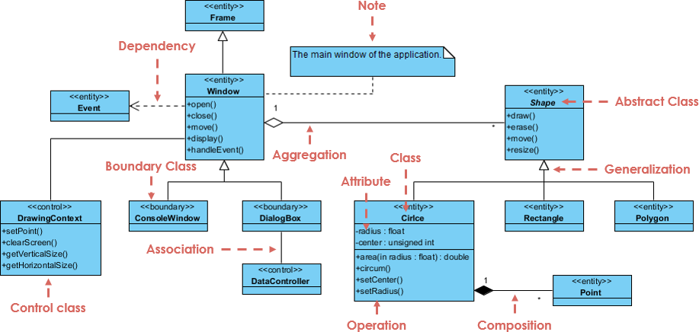
Complex example
From visual-paradigm.com

Slide 130
Upcoming

Slide 131
Next time…
Finish review on Wednesday
Presentations on Friday!

Slide 132
Reminders
Finish Project 4 for Friday
Don't forget Assignment 4 is also due on Friday!
Review for Final Exam on Wednesday

